Slide 1
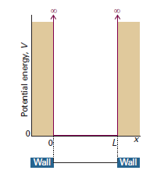
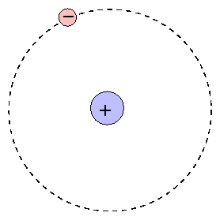
Lecture 2: Exactly Solvable Systems
(x_{e},y_{e},z_{e})

Slide 2
Restrictions on wavefunction
ψ must be a solution of the Schrodinger equation
ψ must be normalizable: ψ must be finite and 0 at boundaries/ ±∞
Ψ must be a continuous function of x,y,z
dΨ/dq must be must be continuous in x,y,z
Ψ must be single-valued
Ψ must be quadratically integrable (square of the wave-function should be integrable)
Boundary conditions: Quantization

Slide 3
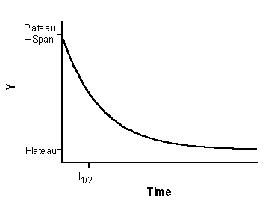
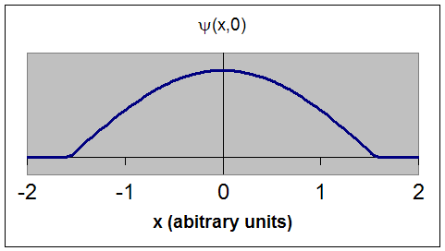
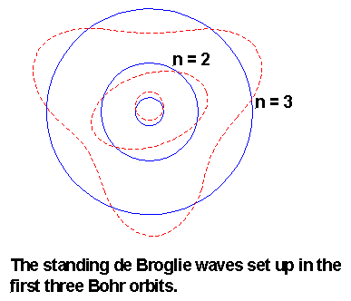
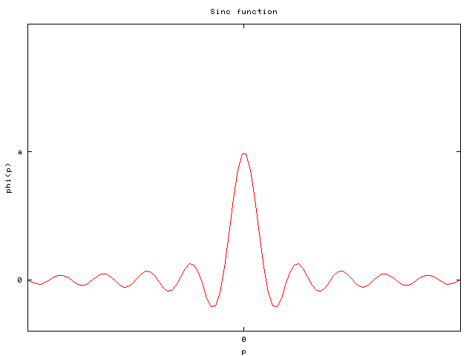
Acceptable wavefunctions

Slide 4
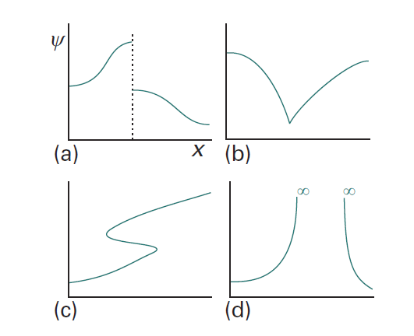
Restrictions on wavefunction
Unacceptable because ψ is not continuous
Unacceptable because dψ/dq is not continuous
Unacceptable because ψ is not single-valued
Unacceptable because ψ goes to infinity

Slide 5
Quantum Mechanics
Examples of Exactly Solvable Systems
Free Particle
Particle in a Square-Well Potential
Hydrogen Atom

Slide 6
Free Particle
Time-independent Schrodinger equation
For a free particle V(x)=0
There are no external forces acting

Slide 7
Free Particle
Second-order linear differential equation
Let us assume
Trial Solution

Slide 8
Free Particle
Second-order linear differential equation
Let us assume
Trial Solution

Slide 9
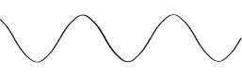


Particle in 2-D Square-Well Potential – Symmetry
V=0
V=0
L_{y}
L_{y}
L_{x}
L_{x}
(1,3)
(3,1)
(1,3)
(3,2)
(2,2)
(2,2)
(1,2)
(3,1)
(2,1)
(1,2)
(2,1)
(1,1)
(1,1)

Slide 10
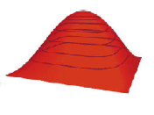
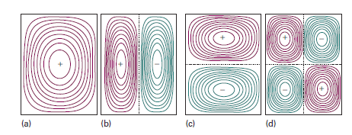
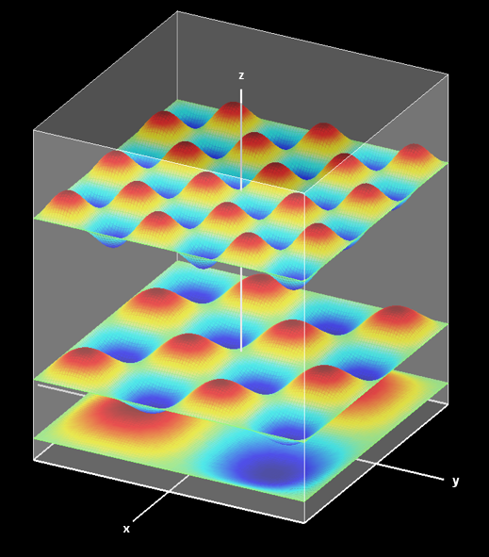

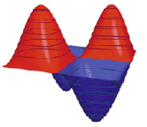
Particle in a 2-D Well – Wavefunctions
Number of nodes = n_{x}+n_{y}-2

Slide 11
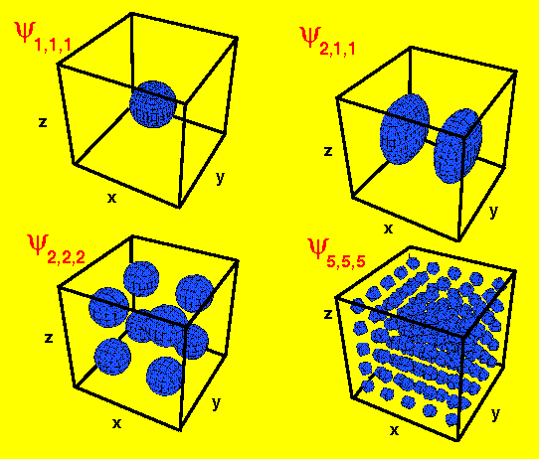
Particle in a 3D-Box

Slide 12
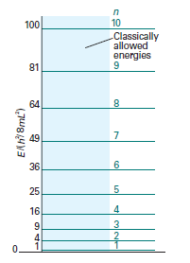
Particle in a 1-D Square Well Potential
Hexatriene is a linear molecule of length 7.3 Å
It absorbs at 258 nm
Use particle in a box model to explain the results.
Agrees well with the experimental value of 258 nm
Particle in a box is a good first approximation



Six π electron fill lower three levels

Slide 13
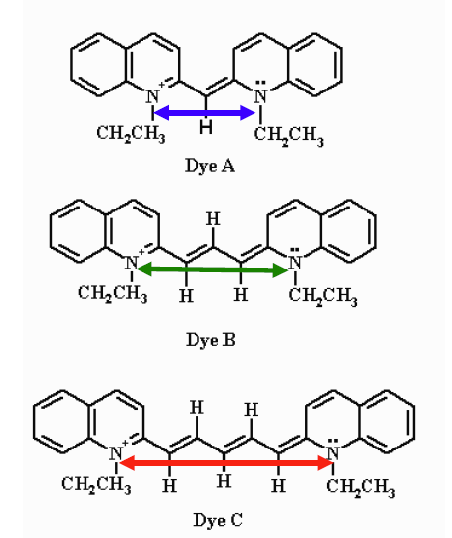
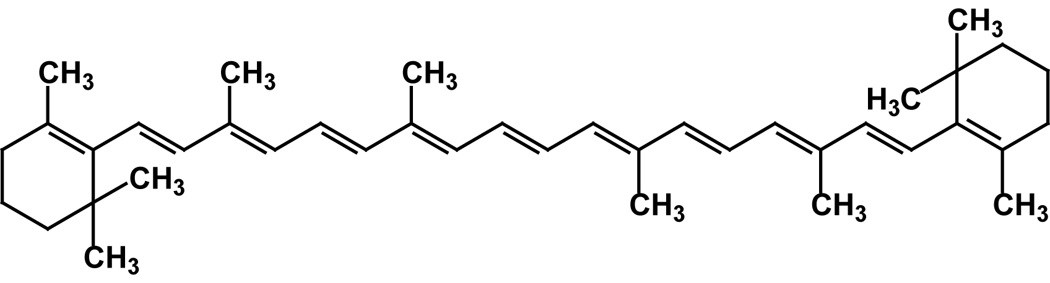
Particle in a Box – Application in Chemistry
Electronic spectra of conjugated molecules
Increase in bridge length increase the emission wavelength.
Predicts correct trend and gets the wavelength almost right.
Particle in a box is a good first approximation
Β-carotene is orange because of 11 conjugated double bonds

Slide 14
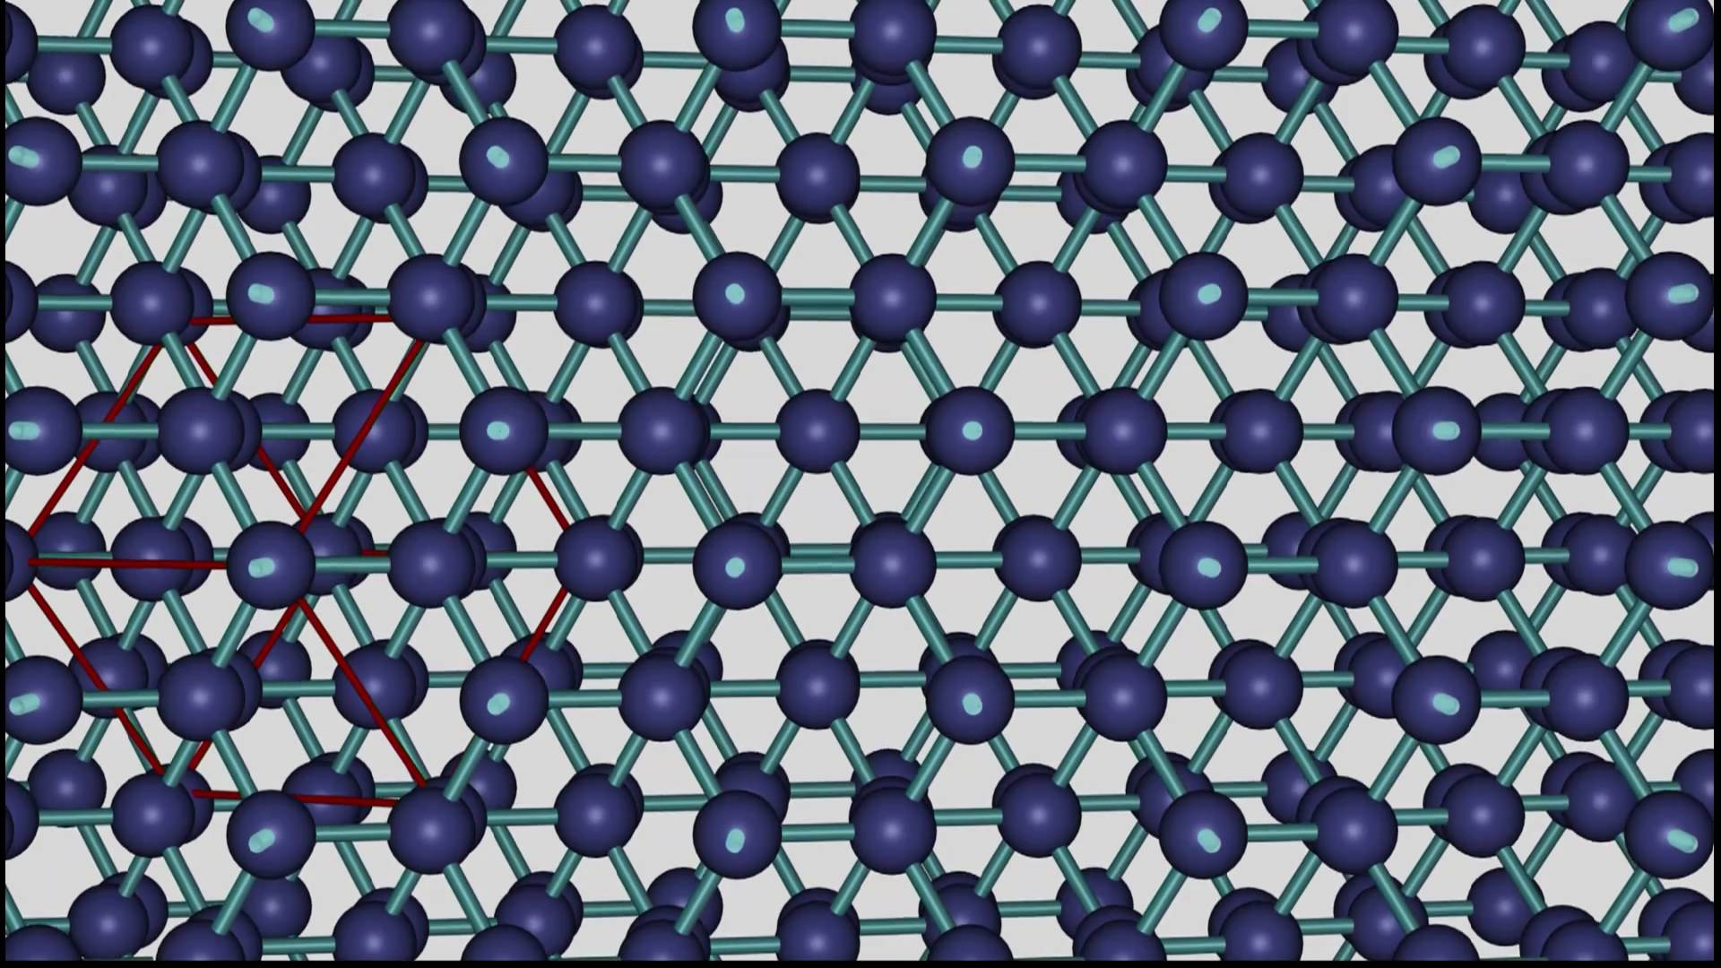
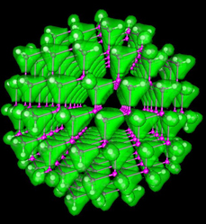
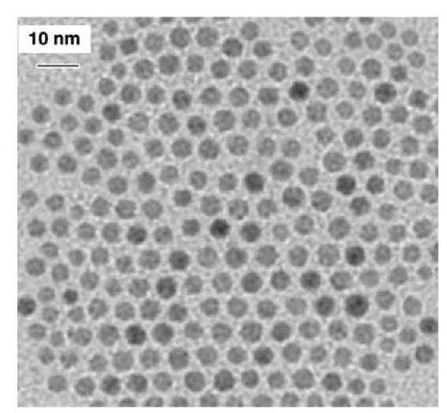
Particle in a Box – Application in nano-science
Quantum Dots – Quasi-particle (exciton) in a Box!
-
+
-
+
-
+
CB
CB
CB
VB
VB
VB
Band gap changes due to confinement,
and so will the color of emitted light

Slide 15
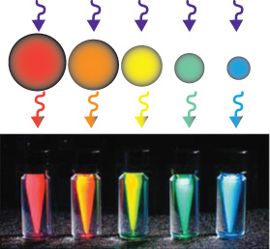
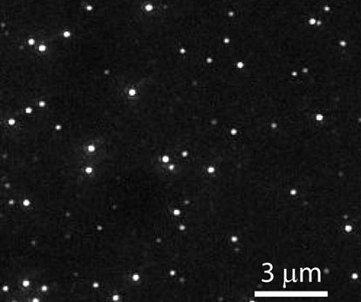
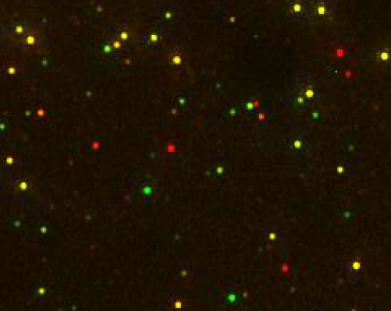
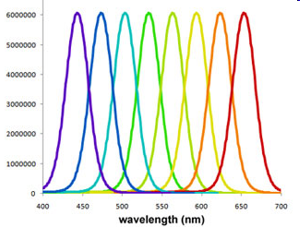
Luminescent semiconductor nanocrystals
VERY VERY BRIGHT

Slide 16
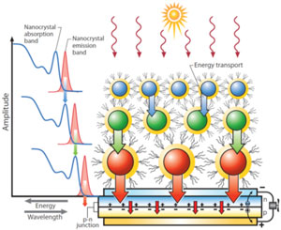
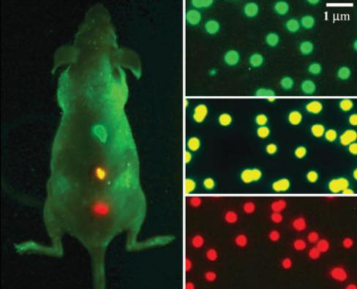
Application of quantum dots
Quantum-Dot based Solar Cells
Quantum-Dot based in-vivo imaging for tumor/cancer

Slide 17
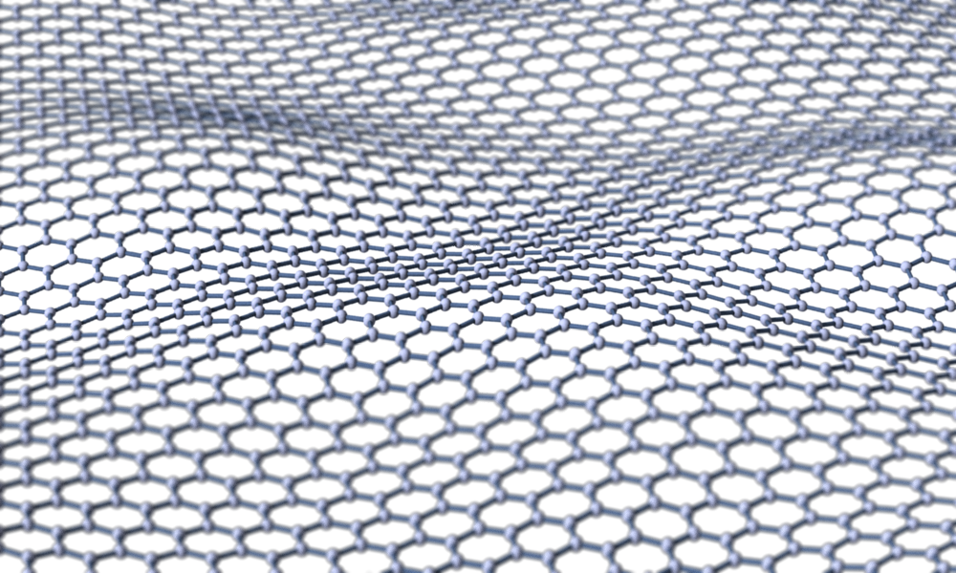
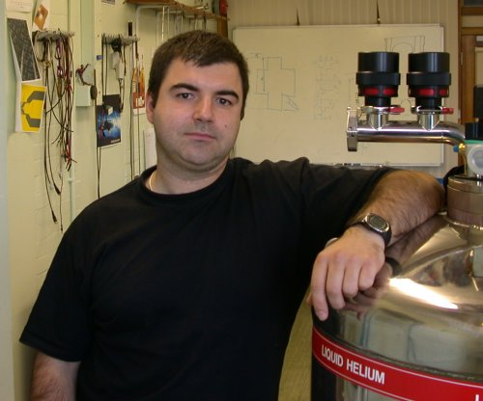
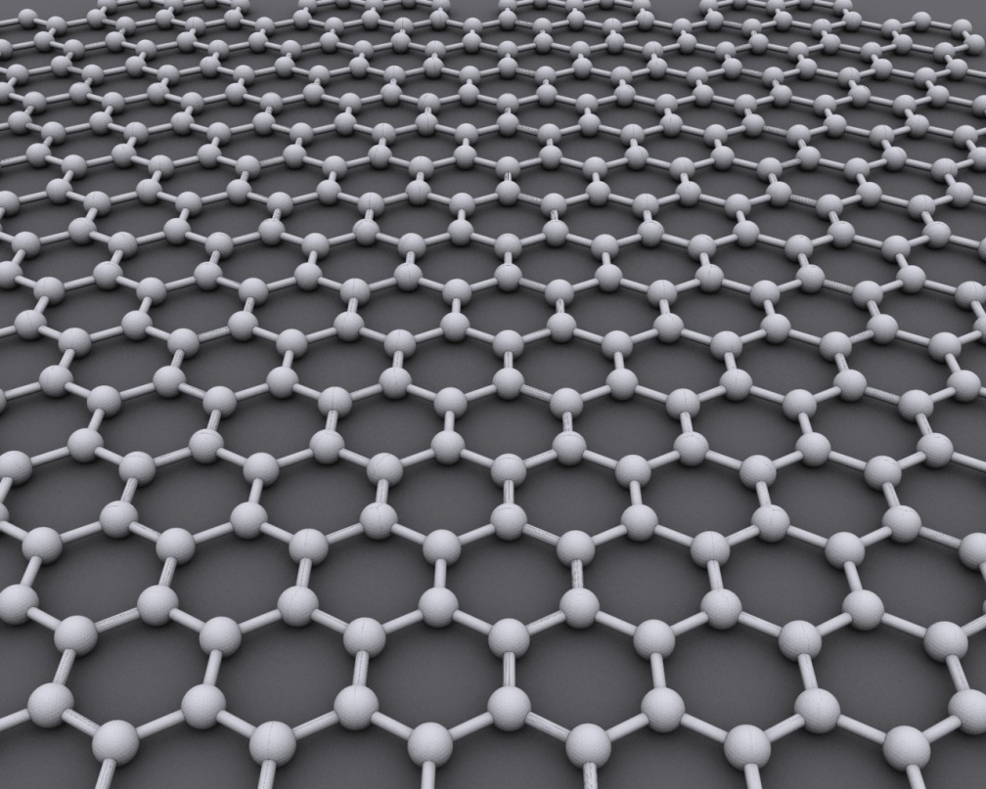
Graphene: 2D box

Slide 18
What have we learnt?
Formulate a correct Hamiltonian
(energy) Operator H
Solve TISE HΨ=E Ψ
by separation of variables and intelligent trial wavefunction
Impose boundary conditions for eigenfunctions and obtain Quantum numbers
Eigenstates or Wavefunctions:
Should be “well behaved” -
Normalization of Wavefunction
Probabilities and Expectation Values

